Slide 1
DATA 690
Ecommerce application for business
Abhishek Goud Thamatam
tf53379

Slide 2
Views and their Functionalities
Business View
Classes: Business and Product
Functions:
Add Employee details
Add Product
Delete Product
Edit Product details
Get Product list
Get product by ID
Show all Products
Customer View
Classes: Cart
Functions:
Show all products
Full details of products by ID
Cart Total value
Add product
Remove product
Show cart sorted by Price

Slide 3
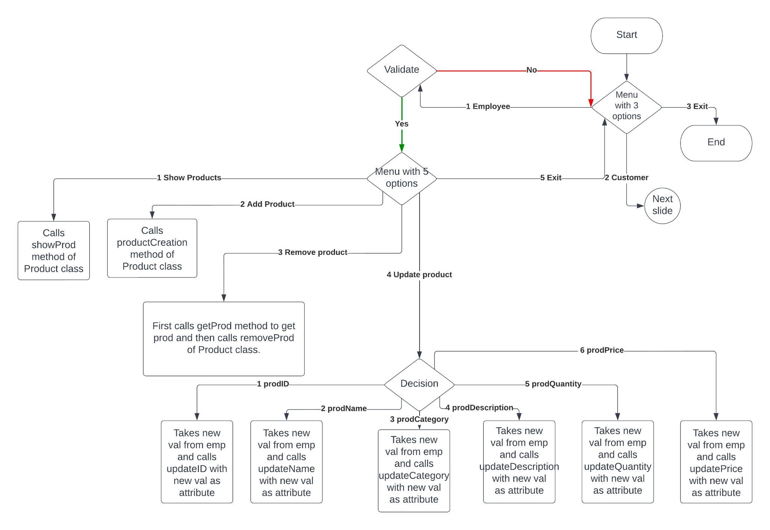
Flowchart - Menu Driven Program

Slide 4
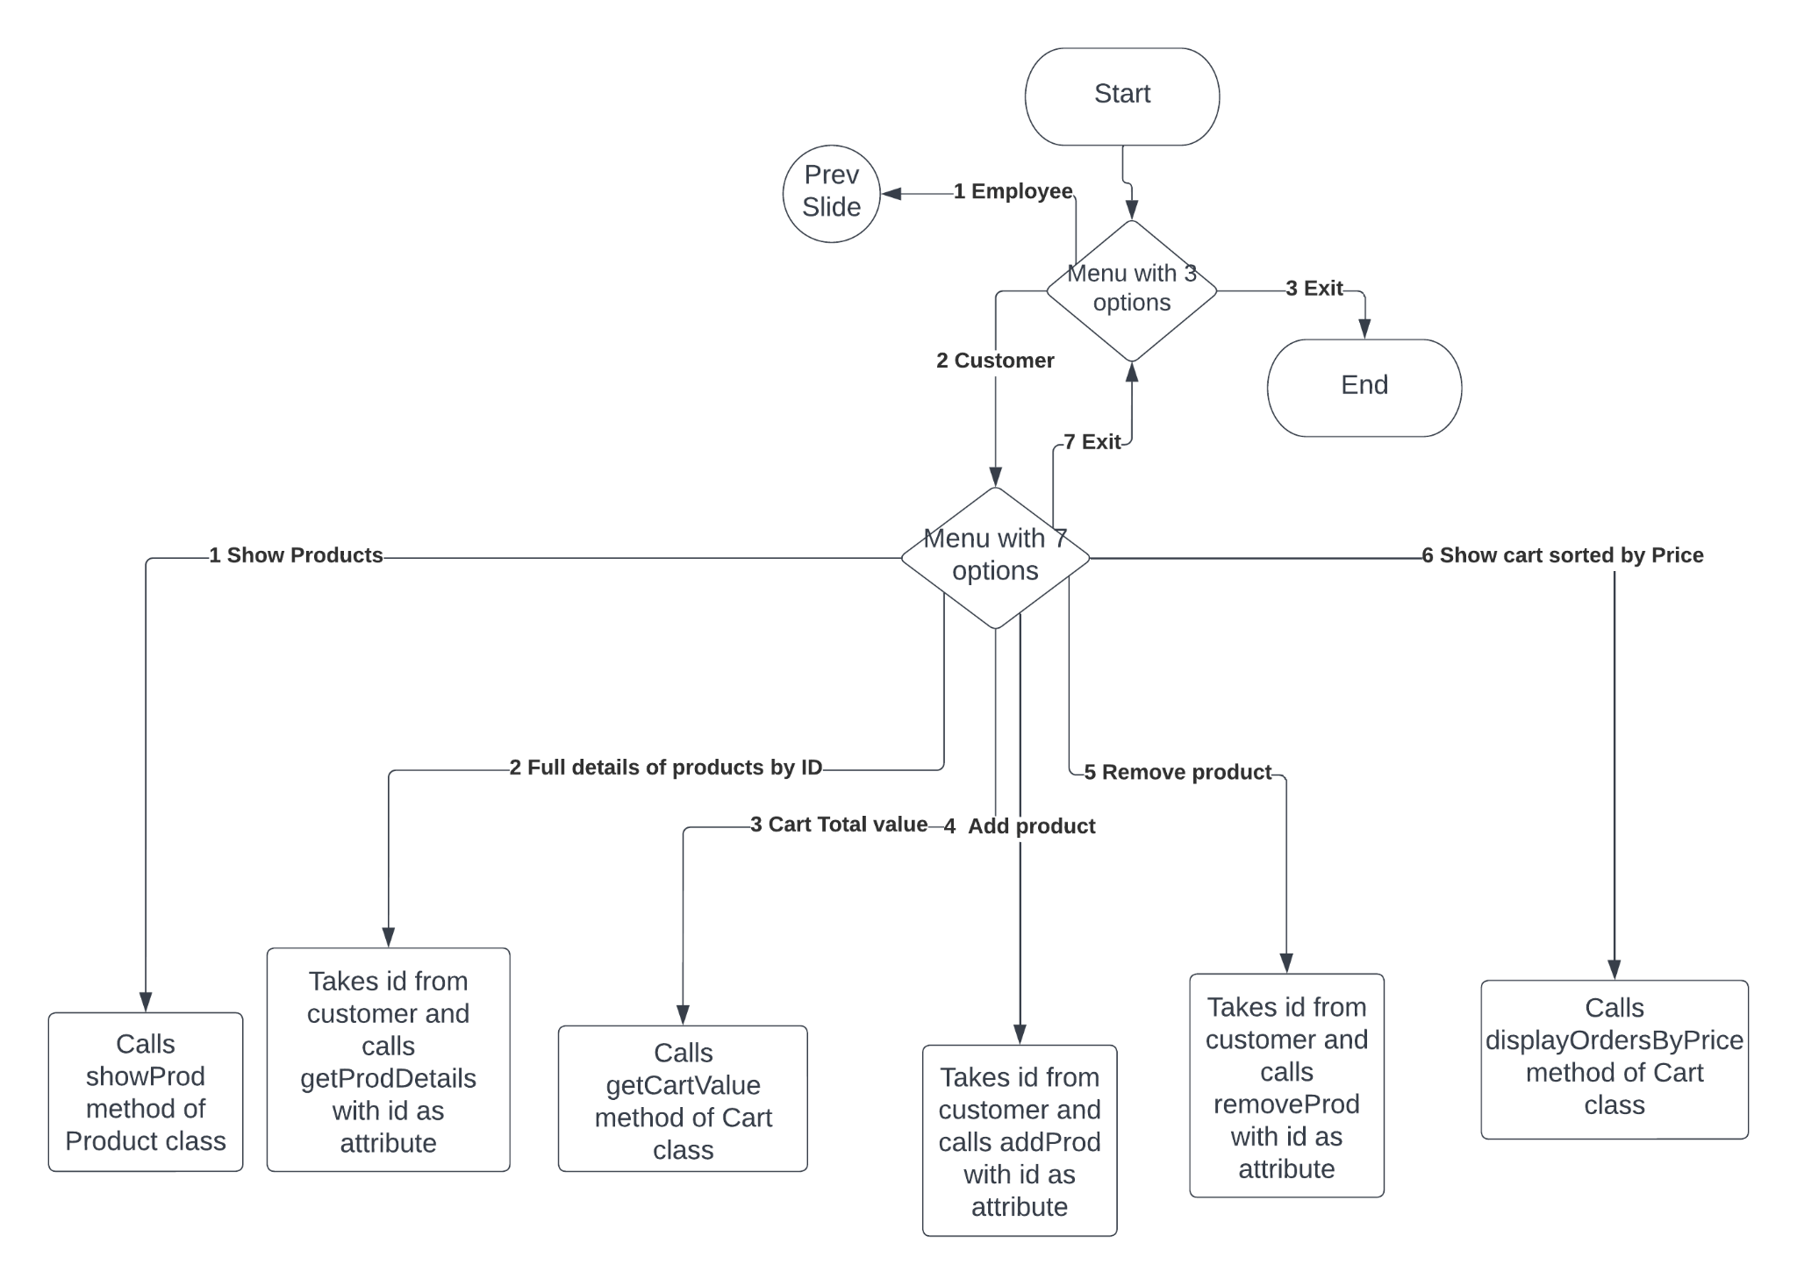
Flow Chart Contd.

Slide 5
Business and Product Class
Business Class has __init__ method which initializes Employee objects.
Class Product has the init method used while creating products and has below methods:
prodsList - This method is used for adding prod Objects to the prods list.
removeProd - This method is used to remove the prod Object from the prod list.
showProd - This method is used to show all products available.
getProdList - This method is used to get the list of product objects(prod list)
getProd - This method is used to get a product obj using the id
updateID, updateCategory, updateDescription, updateQuantity, updatePrice, updateName - These methods are used to update objects using new values which are given as parameters.

Slide 6
Cart Class
addProd - This method adds products to the cart and updates stock accordingly.
getCartValue - This method calculates the total cart value by multiplying the price with the quantity of a prod in the cart.
removeProd - This method removes the product from the cart.
getProd - This method is used to get a product object using product ID.
getProdDetails - This method displays complete information of a prod based on ID like ID, Name, Category, Description, Quantity(Stock), and Price.
displayOrdersByID- This method shows products in the cart by sorting them according to the ID. The sorting Algorithm used is QuickSort.

Slide 7
Updates
This application can be further developed and can be more efficient. Some of them are below:
To create a check for duplicate prodIDs
Remove only the selected number of items from the cart instead of removing everything and adding what is needed as I have done in my implementation.
Can write furthermore Exception handling cases and can add Test cases to cover a few more functions.
Improvement in OOPS implementation.
We even can develop with Databases and UI etc.

Slide 8
Thank You

